Slide 1

Spark Fun Kit
d
Circuits 2A:Buzzer,
Circuits 2B: Digital Trumpet
Circuits 2C: "Simon Says" Gam
UltraSonic Sensor Car
Yusef Emile & Cole Ellis

Slide 2

Outline
Purpose
- Project Components
- Project Design
- Project Implementation
- Code Analysis
- Trouble Shooting
- Conclusion

Slide 3
Purpose
In this experiment we were tasked with implementing the given project(s) to further build our understanding of how hardware and software correlate using arduinos.

Slide 4
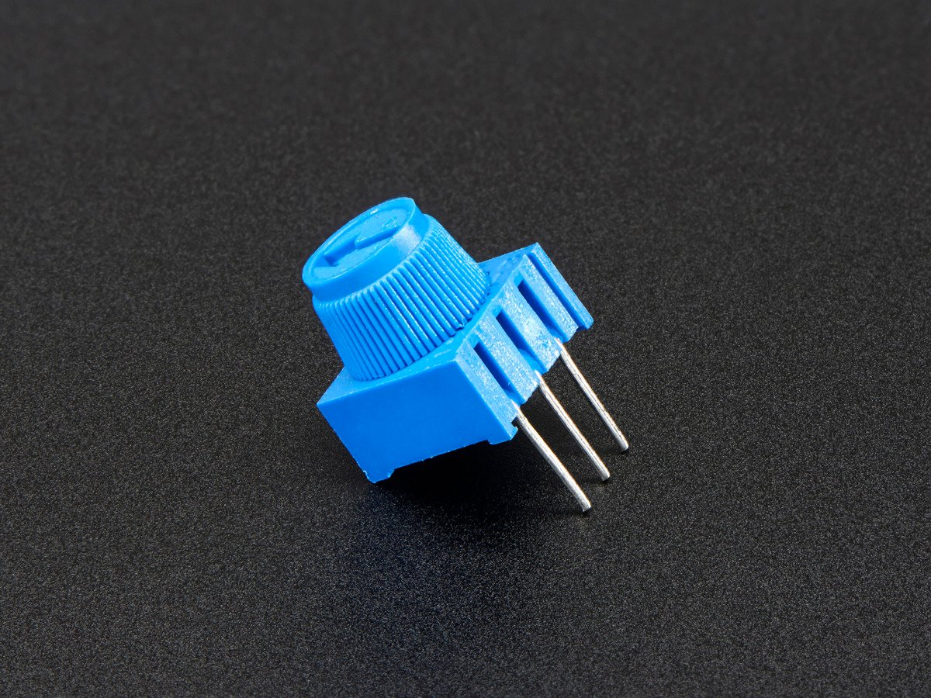
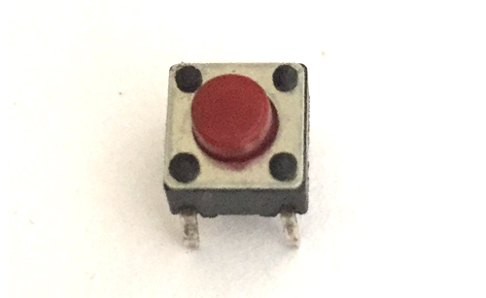
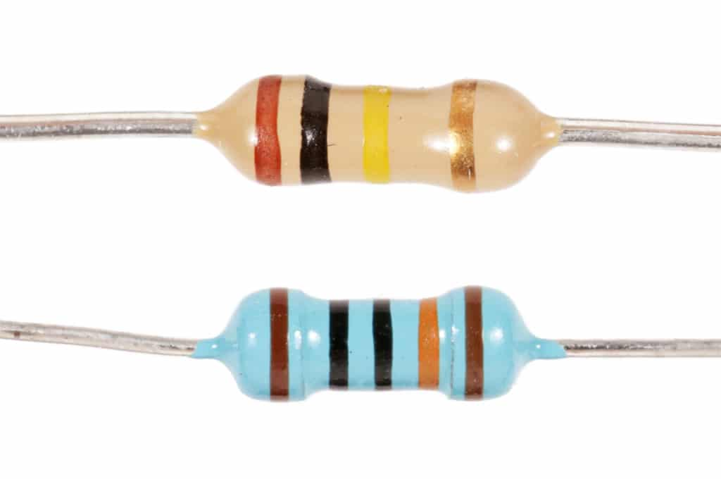
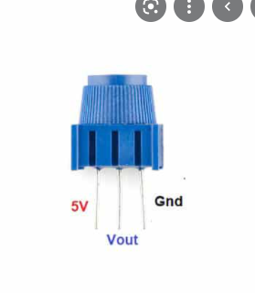
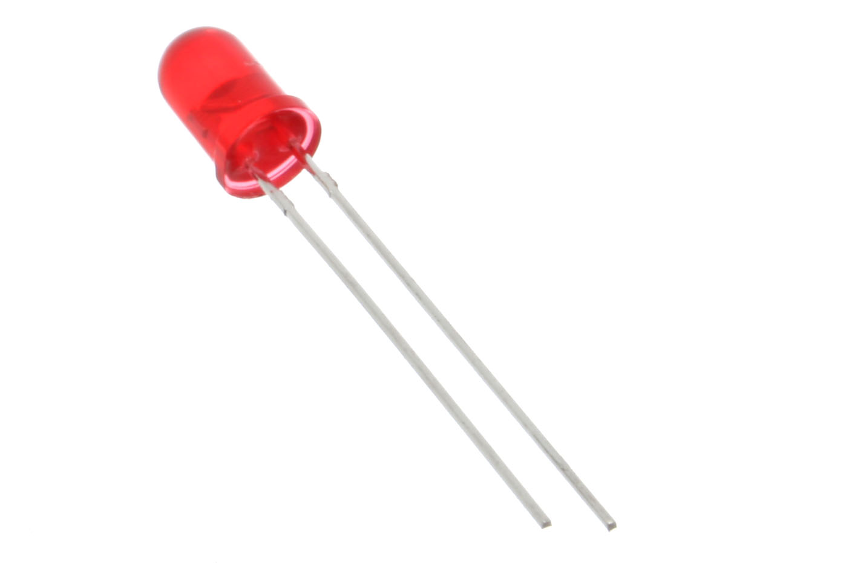
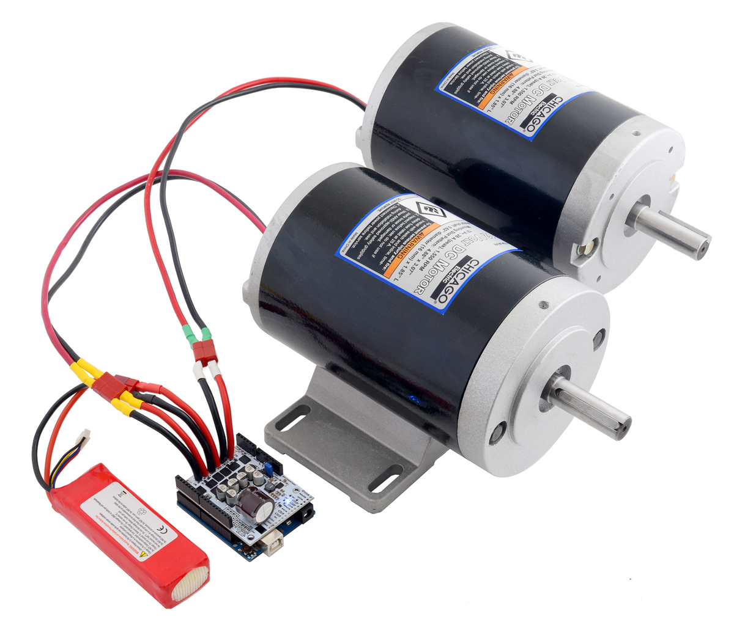
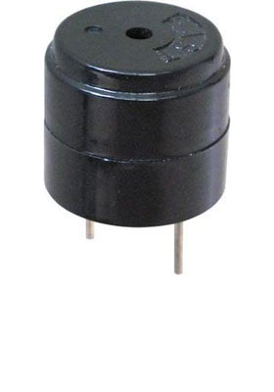
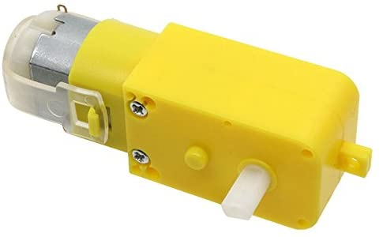
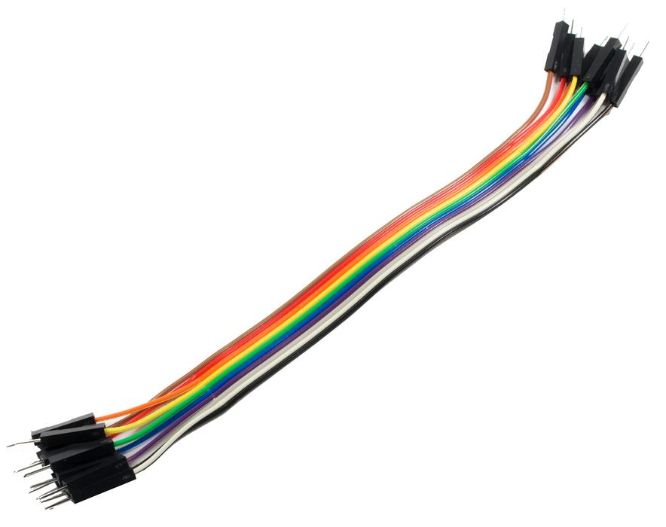
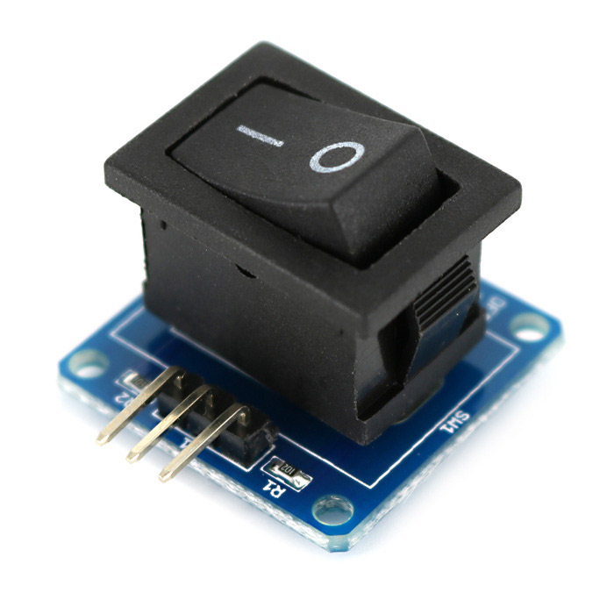
Project Components
Arduino buttons
330 ohm Resistors
Potentiometer
LED
Motor Driver
Piezo Buzzer
Gear Motors
Jumper wires
Switch

Slide 5

Project implementation

Slide 6
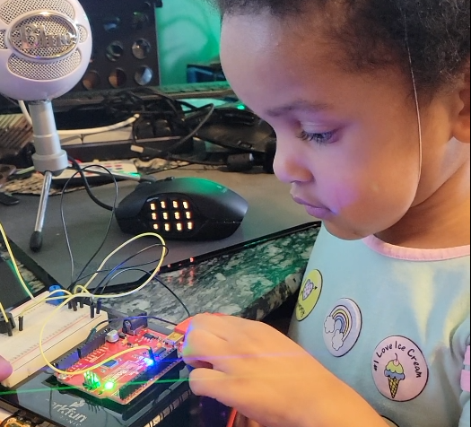
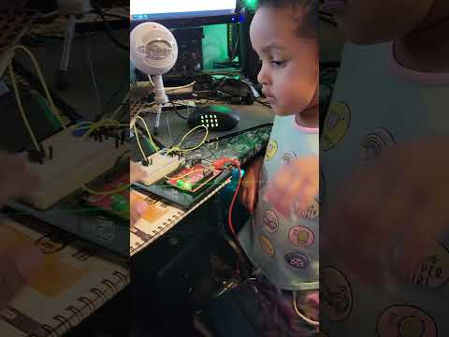
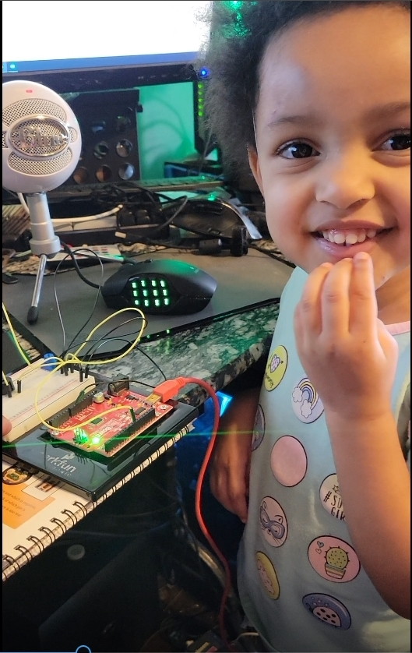
Circuit 2A

Slide 7
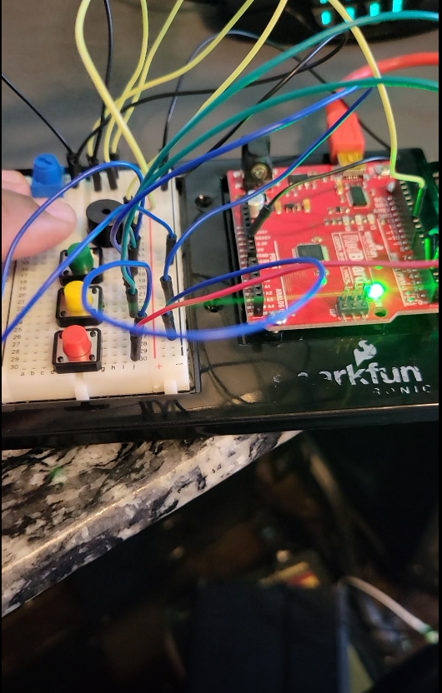
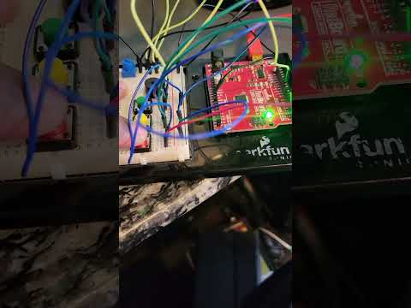
Circuit 2B

Slide 8
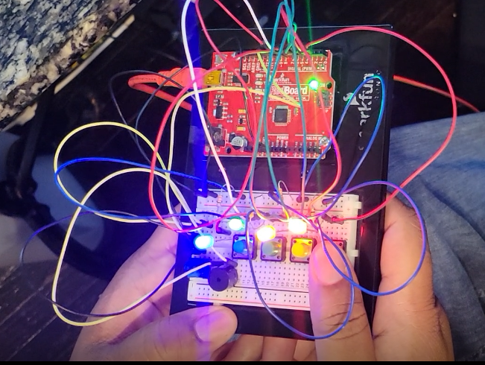
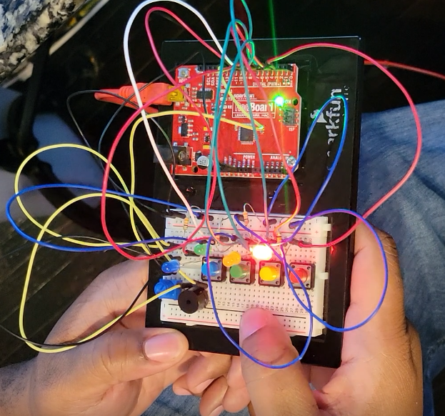
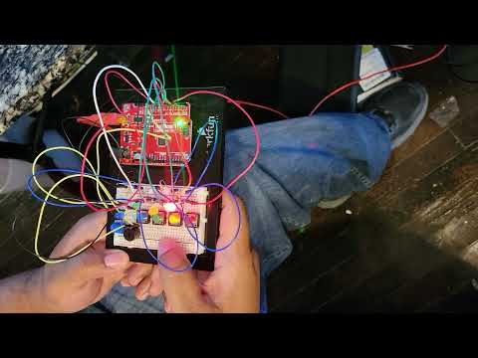
Circuit 2C

Slide 9

Code Analysis

Slide 10
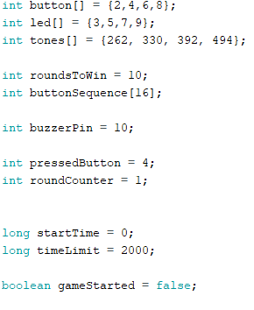
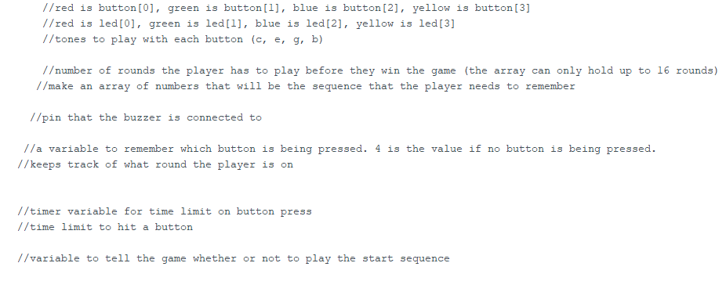
Simon Says
Code
Action

Slide 11
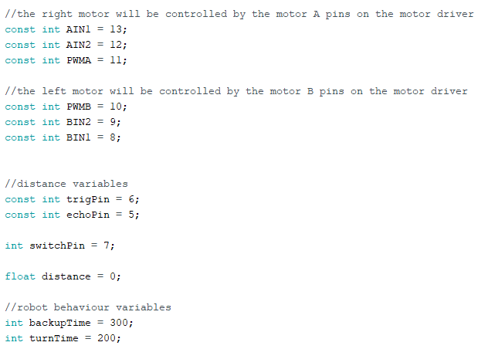
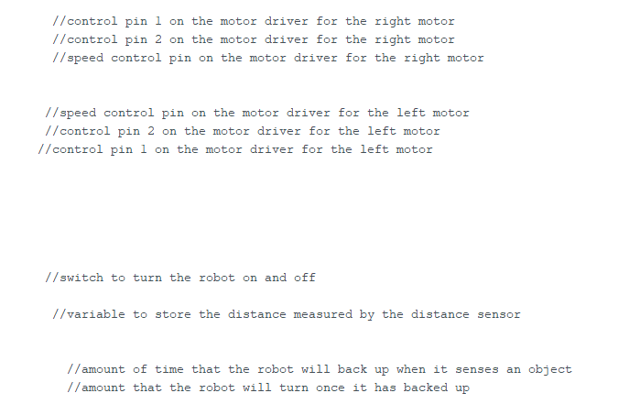
Robotic Car
Code
action

Slide 12

Trouble Shooting

Slide 13
Solutions
Issues
Moved speaker to new spot on breadboard and ran jumper wires from port H1 and H3 to respective terminals on speaker.
Re-examined breadboard connections and re-uploaded code
Initial design as seen in manual gave no output from the speaker component
Error when uploading code from Arduino app to circuit.

Slide 14
Conclusion
As an open source electronic platform with the ability to be used across multiple platforms it is vital to understand how arduinos work as well as the design process. While implementing the following projects we further grew our understanding of the relationship between hardware and software. The correlation between the two when done correctly enables us to control the functionality of a device thus providing an efficient solution for a given problem.

