Slide 1
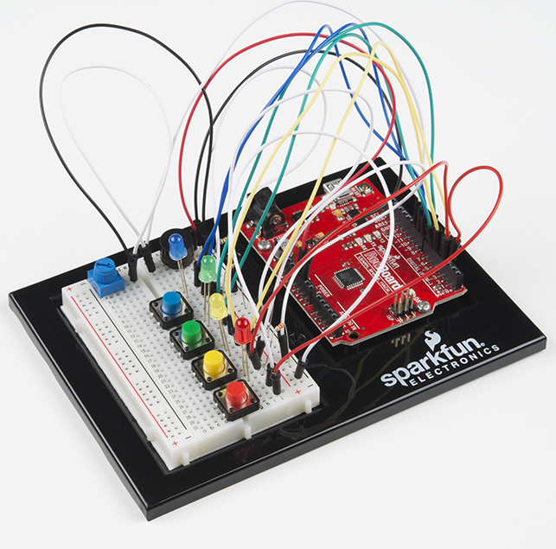
Sparkfun Inventor’s Kit
Digital Logic Design
Dr. Yasser Ismail
November 12, 2021
Janae Minor
Cierra Cage

Slide 2
Table of Contents:
Purpose
Project Components
Project Design
Project Implementation
Code Analysis
Troubleshooting
Conclusion/ Summary

Slide 3
Purpose
The objective of this project is to transfer codes into an Arduino printed circuit board, implement the circuit configuration(s), then verify proper operations of the device.

Slide 4
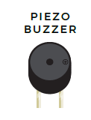
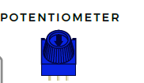
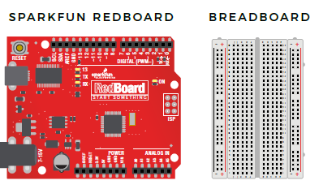
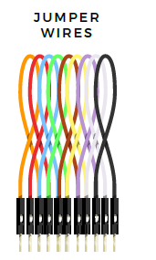
Project Components: Circuit 2A “Buzzer”

Slide 5
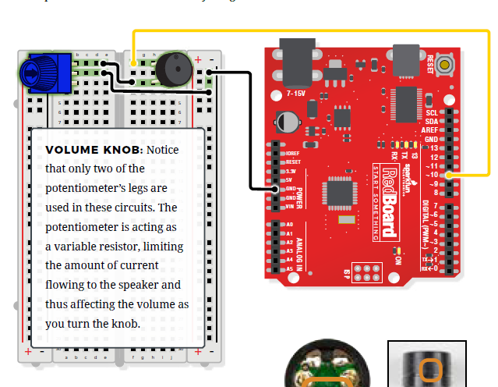
Project Design: Circuit 2A “Buzzer”

Slide 6
Project Implementation: Circuit 2A “Buzzer”
Notes:
Only difference in our circuit vs the instructions pic was that we place the piezo buzzer in “I” instead of “h”.

Slide 7
Video:Circuit 2A “Buzzer

Slide 8
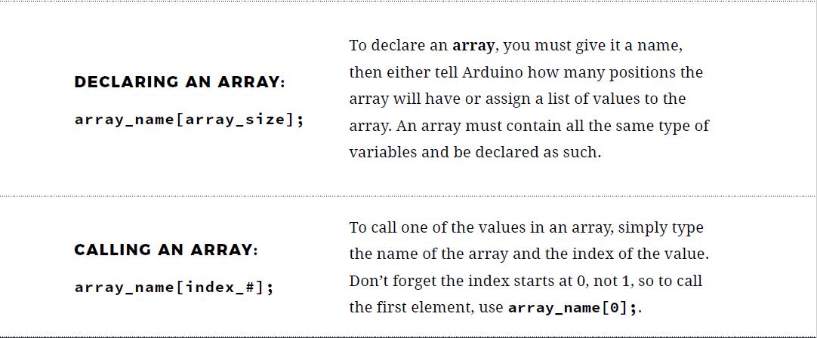
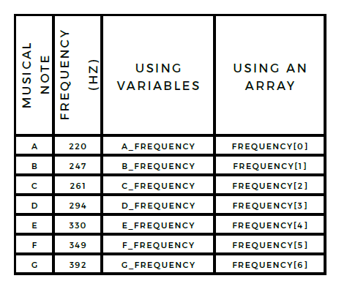
Code Analysis:

Slide 9
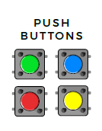
Project Components: Circuit 2B “Digital Trumpet”
Notes:
We used three push buttons.

Slide 10
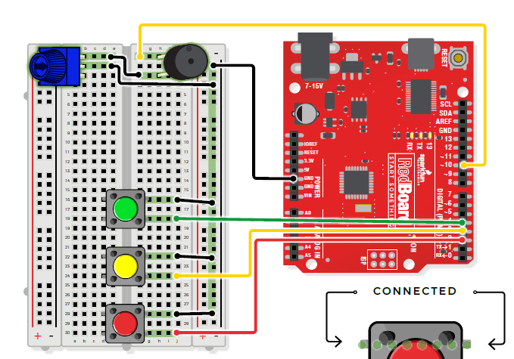
Project Design: Circuit 2B “Digital Trumpet”

Slide 11
Project Implementation: Circuit 2B “Digital Trumpet”

Slide 12
Code Analysis:

Slide 13
Video:Circuit 2B “Digital Trumpet”

Slide 14
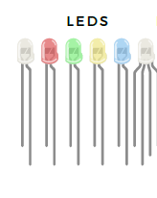
Project Components: Circuit 2C “Simon Says Game”

Slide 15
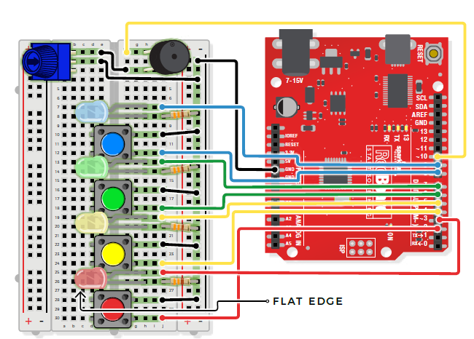
Project Design: Circuit 2C “Simon Says Game”

Slide 16
Project Implementation: Circuit 2C “Simon Says Game”

Slide 17
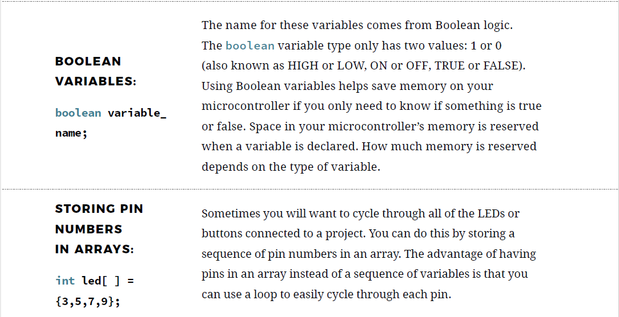
Code Analysis:

Slide 18
Video:Circuit 2C “Simon Says Game”

Slide 19
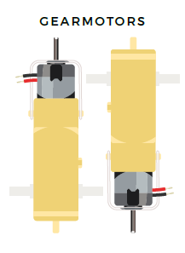
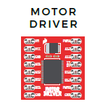
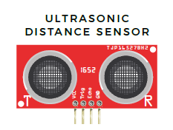
Project Components: Circuit 5C “Autonomous Robot”
Scissors
Dual Lock Tape
Binder Clip
2 Wheels
4- AA Batteries

Slide 20
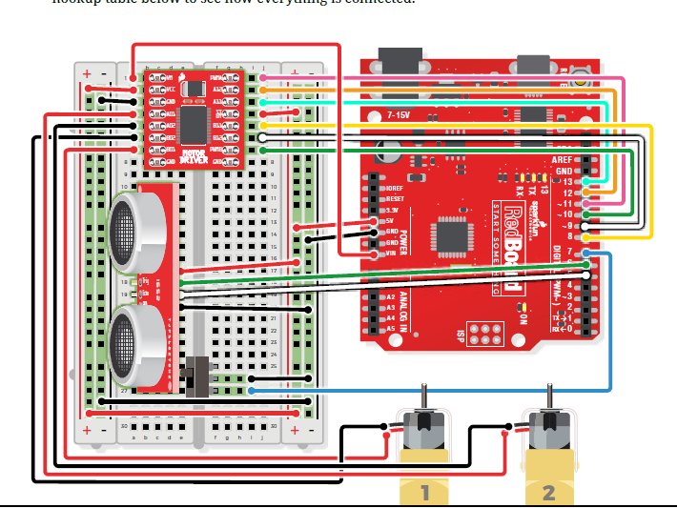
Project Design: Circuit 5C “Autonomous Robot”

Slide 21
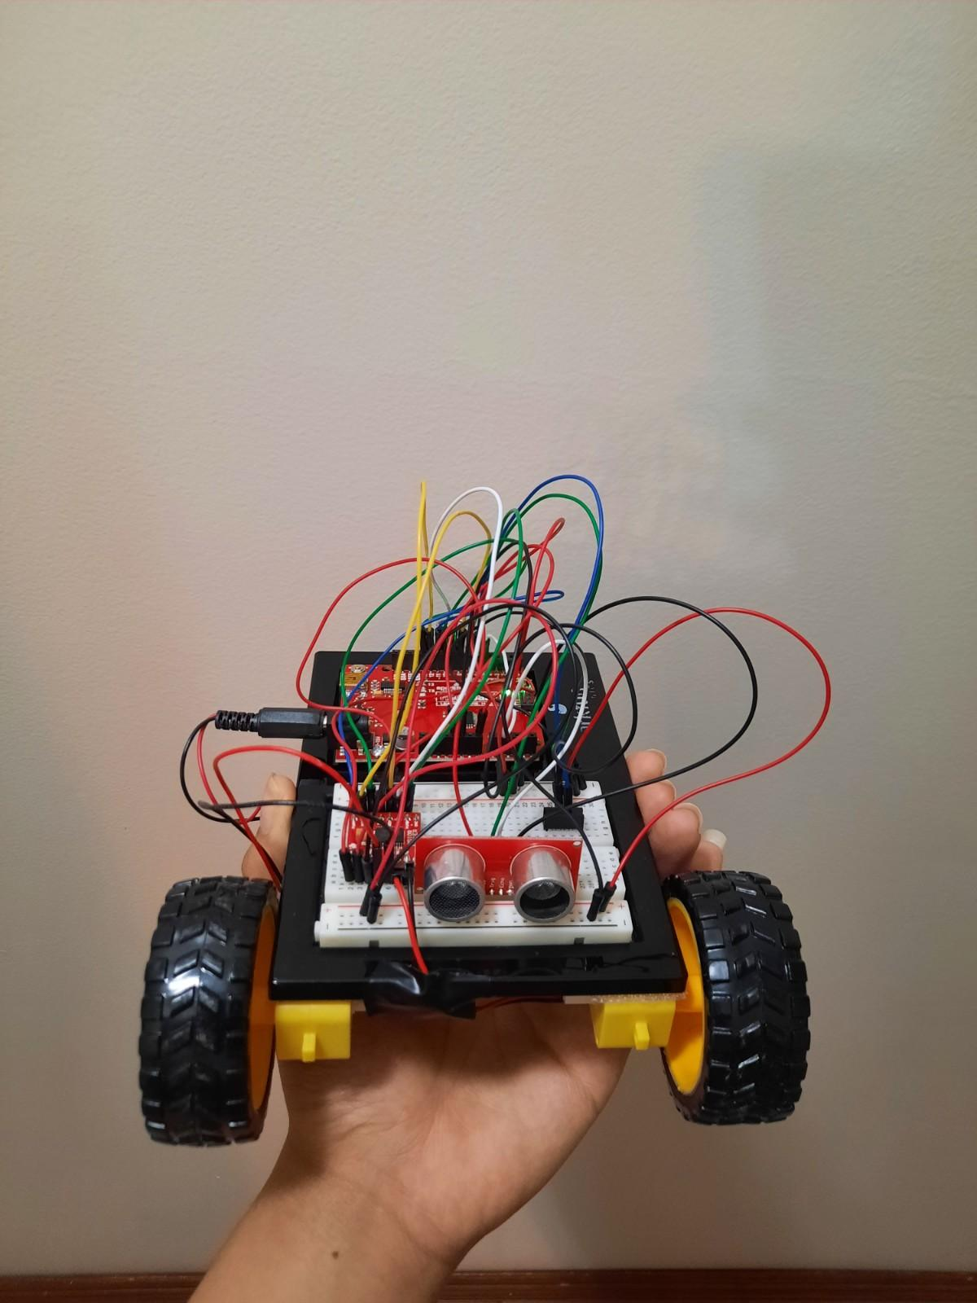
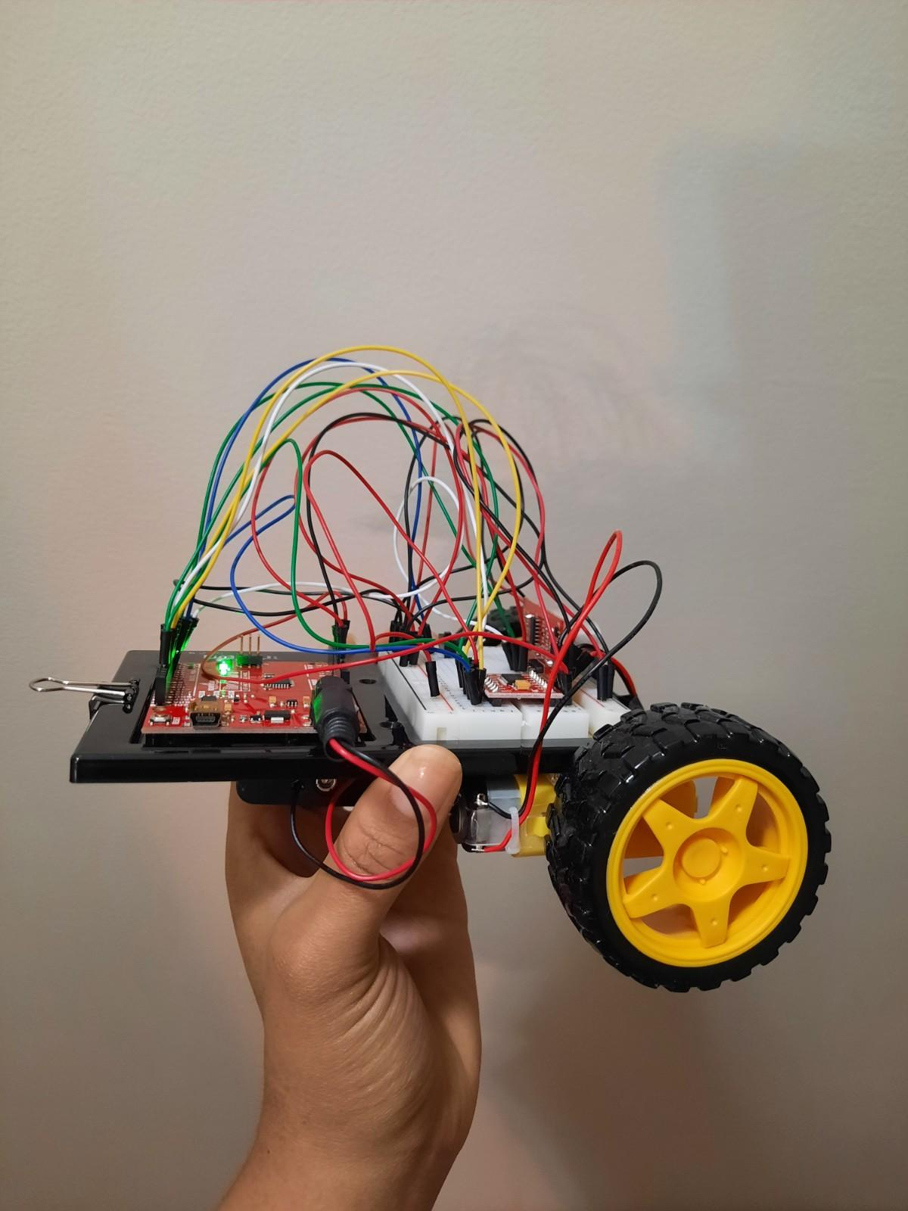
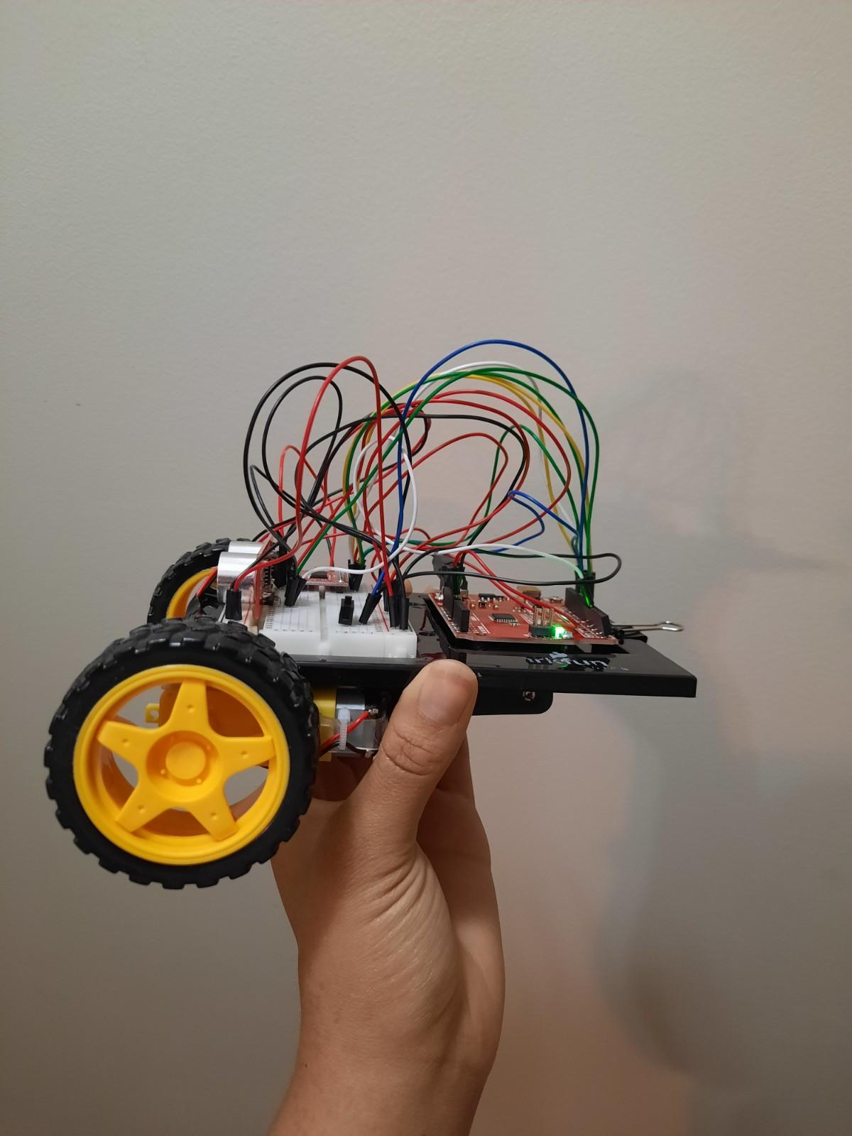
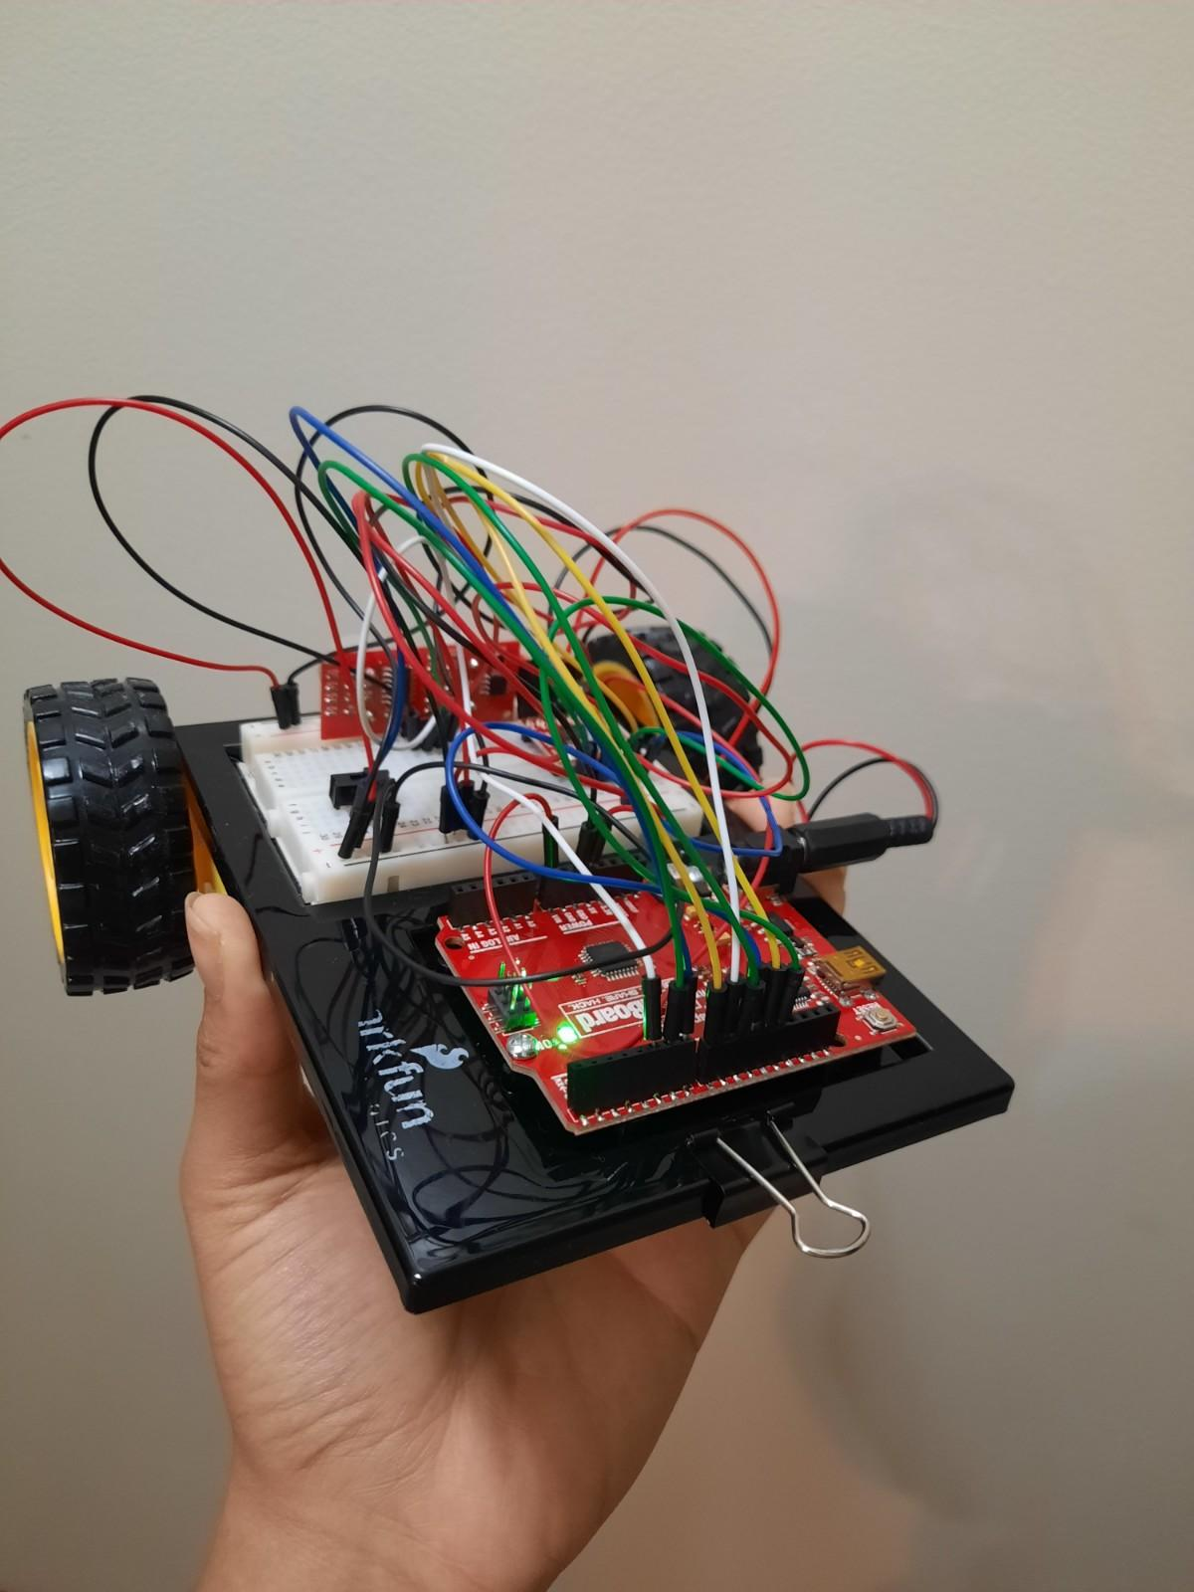
Project Implementation: Circuit 5C “Autonomous Robot”

Slide 22
Code Analysis:

Slide 23
Video: Circuit 5C “Autonomous Robot”

Slide 24
Troubleshooting
Problem(s):
For 2A: Buzzer, when attempting to upload the code to the circuit, we received the message “An error occurred while uploading the sketch”.
For 2B: Digital Trumpet, the green and yellow push buttons would not produce sound.
For 2C: Simon Says, once the game started we noticed that only two of the LED’s lit up, therefore we did not know which button to push for the game (there was only sound).
For 5C“Autonomous Robot”, once we switched the robot on it moved in a doughnut/spin motion. Eventually, the robot begin to drive backwards.
Solution(s):
On Ardunio IDE, we selected Help > Troubleshooting and searched our problem. We realized that we had to go to Tools, and select Board > Arduino Uno. Then, go to Port and Select “COM4”. Once we did this the code was able to successfully upload.
We checked the wiring and notice that the green and yellow wires from PWM were not connected in the correct row. We then placed the wiring correctly then both buttons produced sound.
We simply removed the faulty LED’s and replaced them with new ones and they produced light.
We noticed that the wheels were spinning in opposite direction. The right was turning forward where the left was turning backwards. So we switched one of the gearmotors around. However both wheels begin turning backwards. We removed the adhesive and flipped and reattached each gear motor so that the wheels turned forward.

Slide 25
Conclusion/ Summary
Troubleshooting/Debugging: finding the issue(s) and correcting them.Ex. Port>COM4
Exposure of codes: Noticed how certain codes (numbers and words) can affect the function of the device. Ex. the frequency value can affect the tone/pitch of sounds
Identifying and Understanding: Relate the coding languages to the functions of the circuit

