Slide 1
“PROJECT 2”
By: Keria Snowden
Isaiah Rollins
Class: Digital Logic Design 303B-01

Slide 2
PURPOSE
Learning the concept of coding and implementing buzzers while building a game of “Simon Says”.
To learn how to program tones into a circuit and an output buzzer.
How to evaluate and code buttons using digital inputs

Slide 3
GAME COMPONENTS
BUZZER
SIMON SAYS
DIGITAL TRUMPET
Potentiometer
Piezo Buzzer
4 Jumper Wires
4 LEDS
Potentiometer
Piezo Buzzer
16 Jumper Wires
4 Push Buttons
4 330 ohms Resistors
Potentiometer
Piezo Buzzer
10 Jumper Wires
3 Push Buttons

Slide 4
GAME DESIGN
We implemented the project through 3 phases.
The first phase was creating the Buzzer circuit. We used the red board and the small buzzer to make a song after connecting the red board to a usb port. The song chosen to verify if the buzzer was working was Happy Birthday. Using the play() function the song was played from the buzzer.
In the second phase we created the Digital Trumpet circuit , in which different sounds played when we pressed different keys through the Arduino IDE. For C 1st key we set it to 523 frequency on high , second key to Low e frequency 330 and third key frequency LOW g to 392.

Slide 5
GAME DESIGN CONT…
In the 3rd phase which we implemented the Buzzer and Digital Trumpet circuit to create the game “ Simon Says”. 10 games out of 16 was done. The LEDs were set to yellow=0, blue=2, red=3, and green =3 to see the flash and tones played connected to it. Using the button sequence the game was set a default to 1.5 seconds to press correct button. However, we was not able to get through the 10 rounds ☹.

Slide 6
GAME IMPLEMENTATIONS
Buzzer
Digital Trumpet
Simon Says

Slide 7
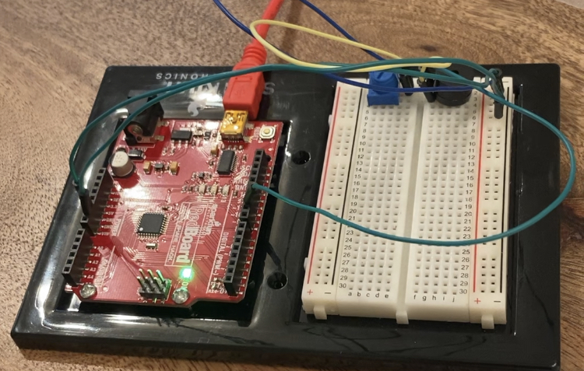
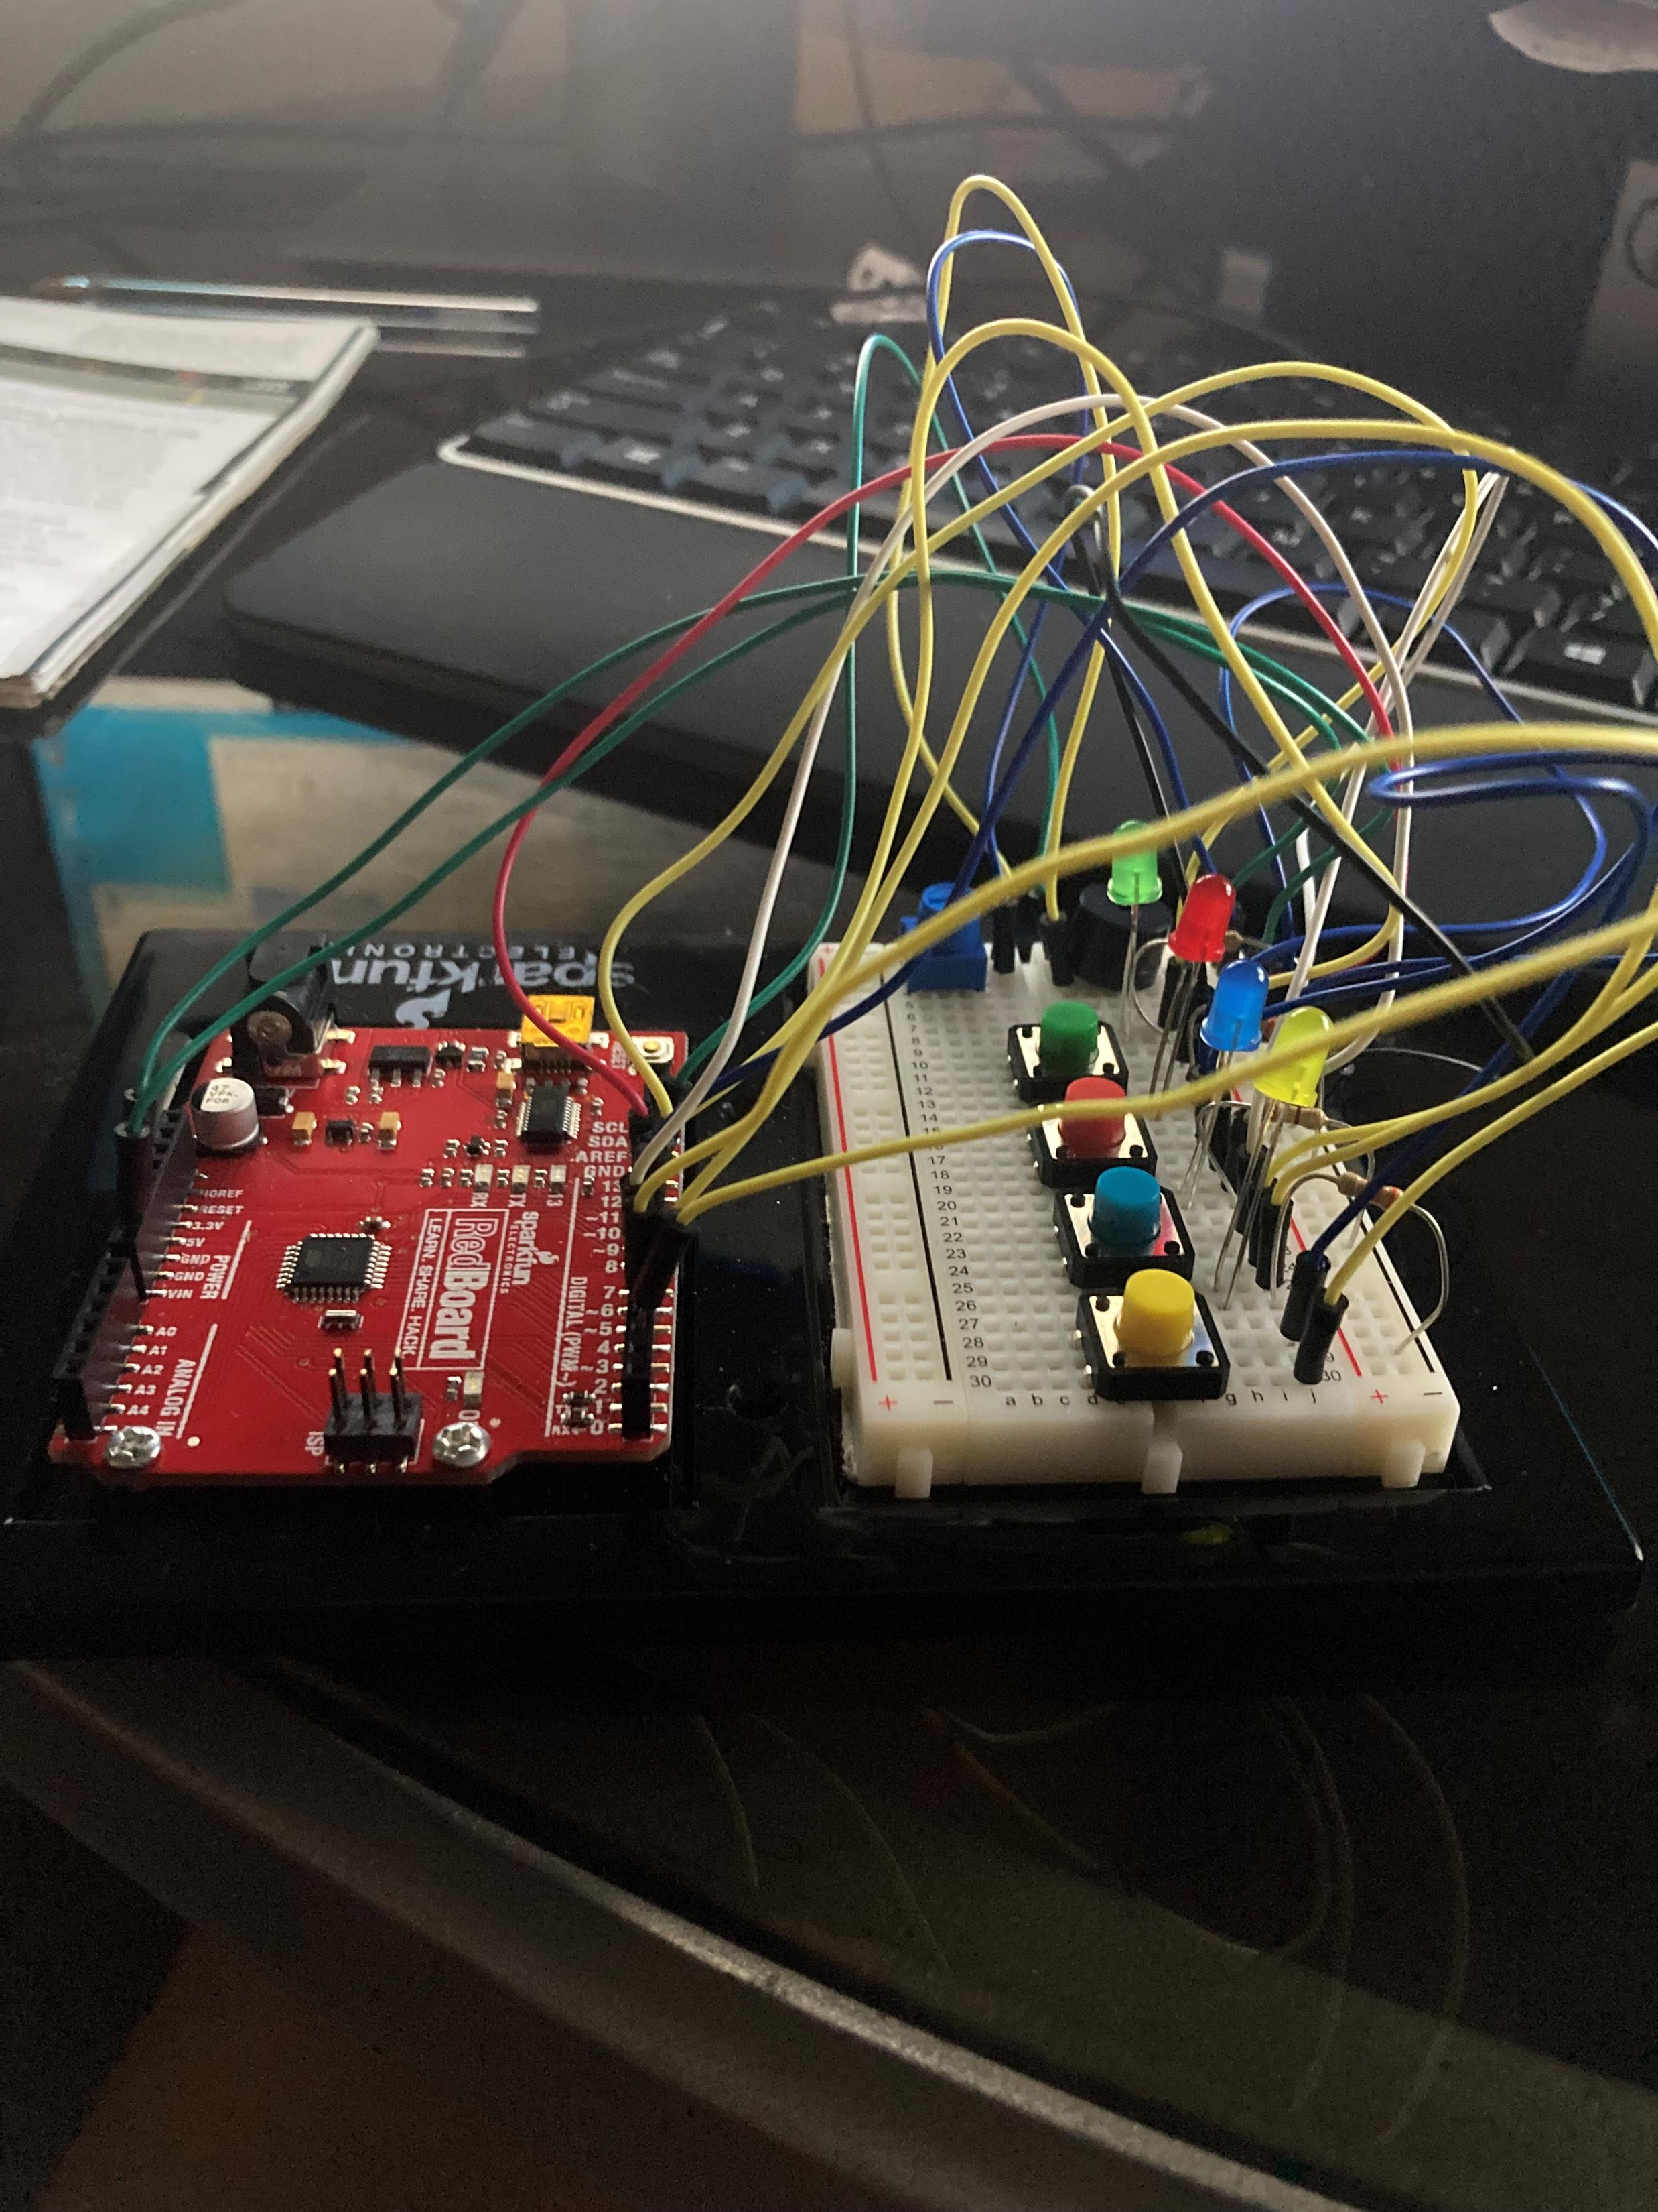
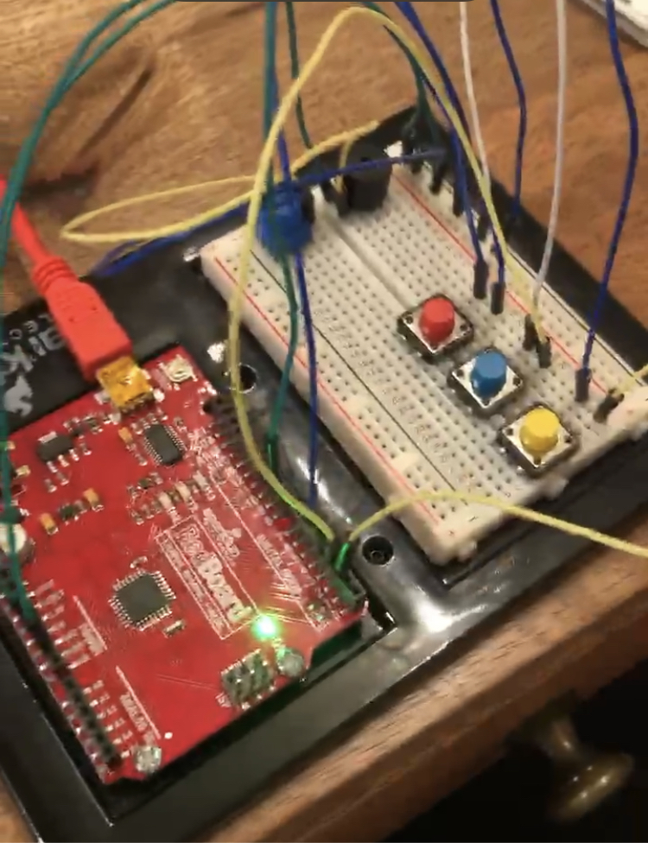
GAME IMPLEMENTATIONS CONT…
Top: Buzzer circuit
Bottom left: Digital Trumpet
Bottom right: Simon Says

Slide 8
CODE ANALYSIS
Tone(pin, frequency, duration)- for the tone() function it will bring power to a pin at a certain frequency and controls how long the sound will play.
void play(char note, int beats)- function gets passed two variables: a character variable that represents the musical note we want to play that represents a frequency and an integer variable that represents how long to play that note.
pinMode(pin, INPUT_PULLUP)- function holds the pin position up so the floating charge in the circuit doesn’t give a false pushed button to the red-board
Else If (digitalRead(pin) == LOW) – this explain to the code that “nothing beside that button is pushed; play a low sound which is follow by a tone function “Tone(buzzer pin, frequency)
lose Sequence()- Plays a sequence of tones, turns all of the LEDs on, and then waits for the player to press a button. If a button is pressed, restarts the game.

Slide 9
TROUBLESHOOTING
ERROR | SOLUTION
On the First run through of the Simon says game we noticed Green LED was not receiving any power to illuminate. | Removed the resistor that connected to the wire placed it back and made sure it was secure with a wiggle.
The Happy Birthday song was not playing after implemented | Used the blue potentiometer to adjust the sound
One button wasn’t working on the Digital Trumpet | Wire was connected from redboard to the wrong input of the powerboard. We had to retrace our steps to put wire into correct input

Slide 10
Conclusion
In conclusion, we used a three-step building process that allowed us take make each subcomponent for the Simon says game. First implementing the Buzzer to clarify that it works and does emit a sound when programmed. Next, we built a trumpet that creates a resulting output frequency when a specific button is pushed and programmed with a specific sound. The last step was to fully implement the Simon says games from the previous first two steps and adding program requested sequences. If the sequences where not followed as specified by the program, then the lose sequence will play and give a sign of blinking lights and frequencies played in a song.

