Slide 1
ELEN 445
RENEWABLE
ENERGY
PROJECT
EXPERIMENTS

Slide 2
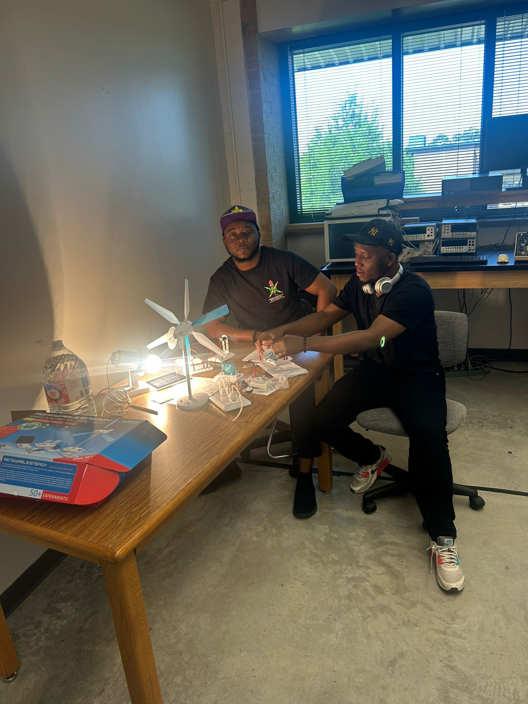

Slide 3
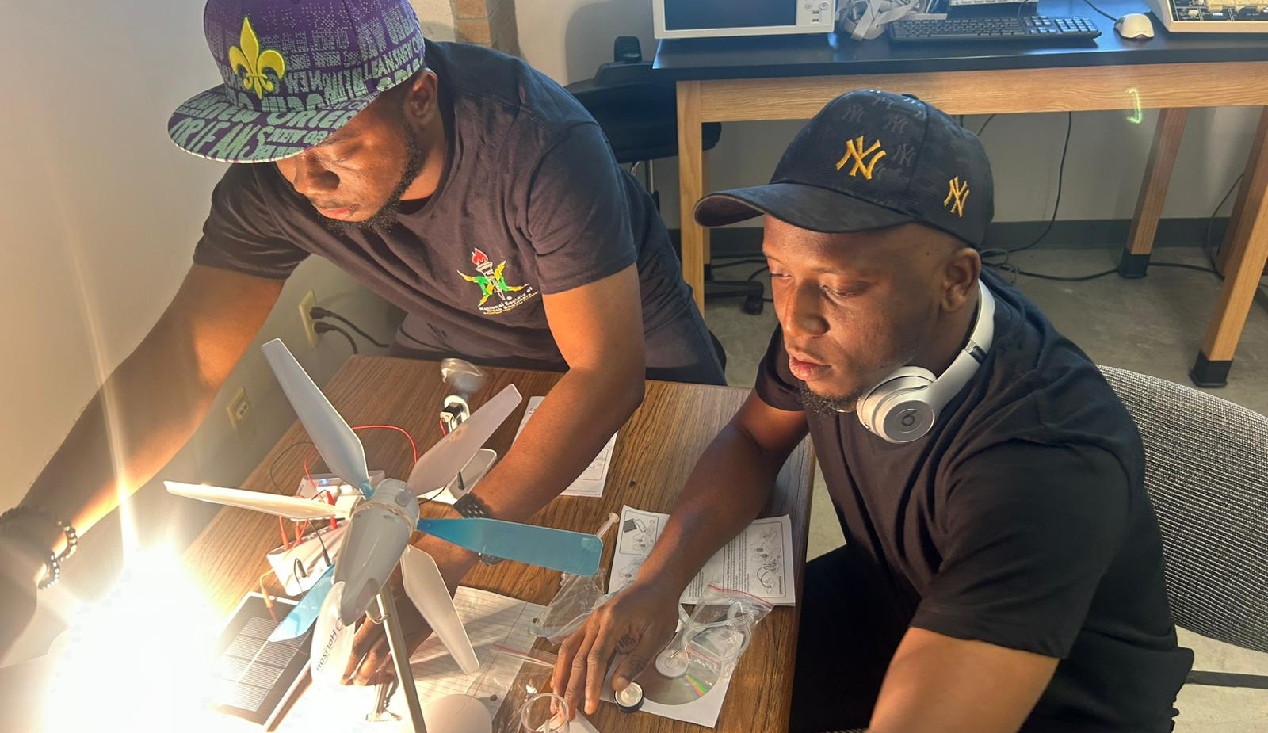

Slide 4
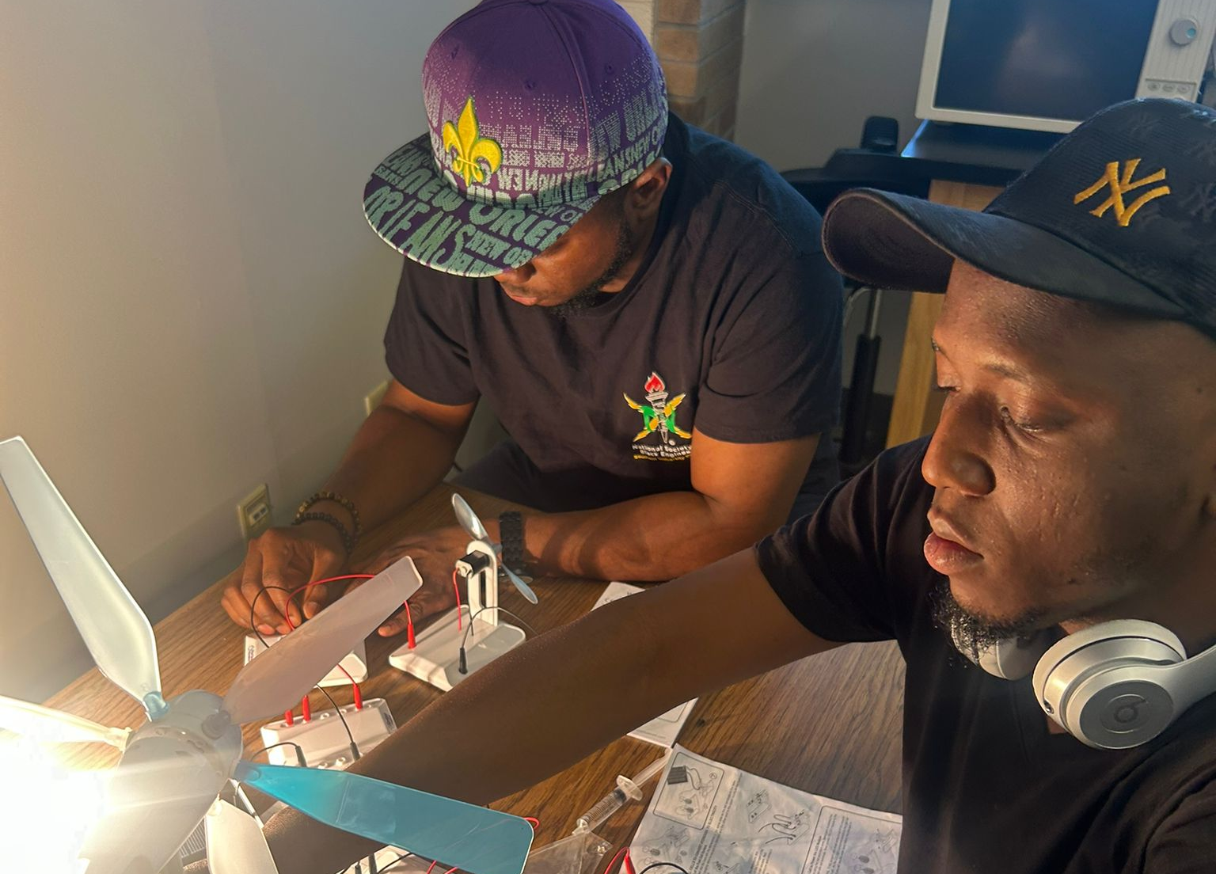

Slide 5
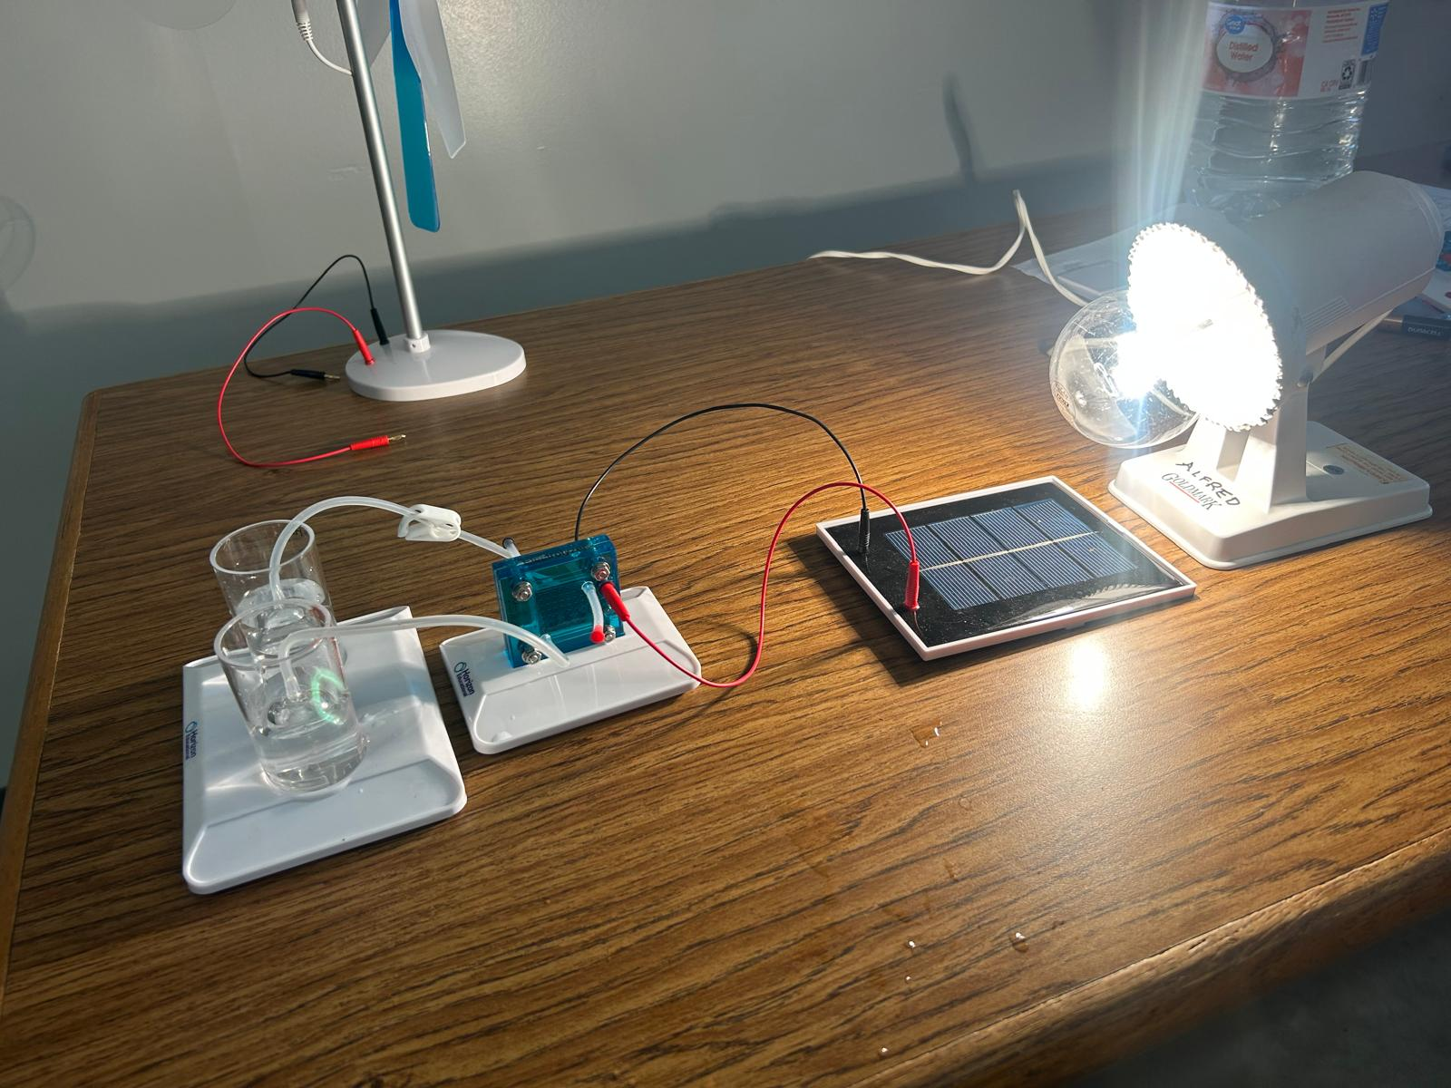

Slide 6
EXPERIMENTAL VIDEOS

Slide 17
THE END

