Slide 1
The Blinking LED Project
Ne’Kirian Guidry
Jamir Williams
Joshua Davis

Slide 2
Design for One LED

Slide 3
Project in Action

Slide 4
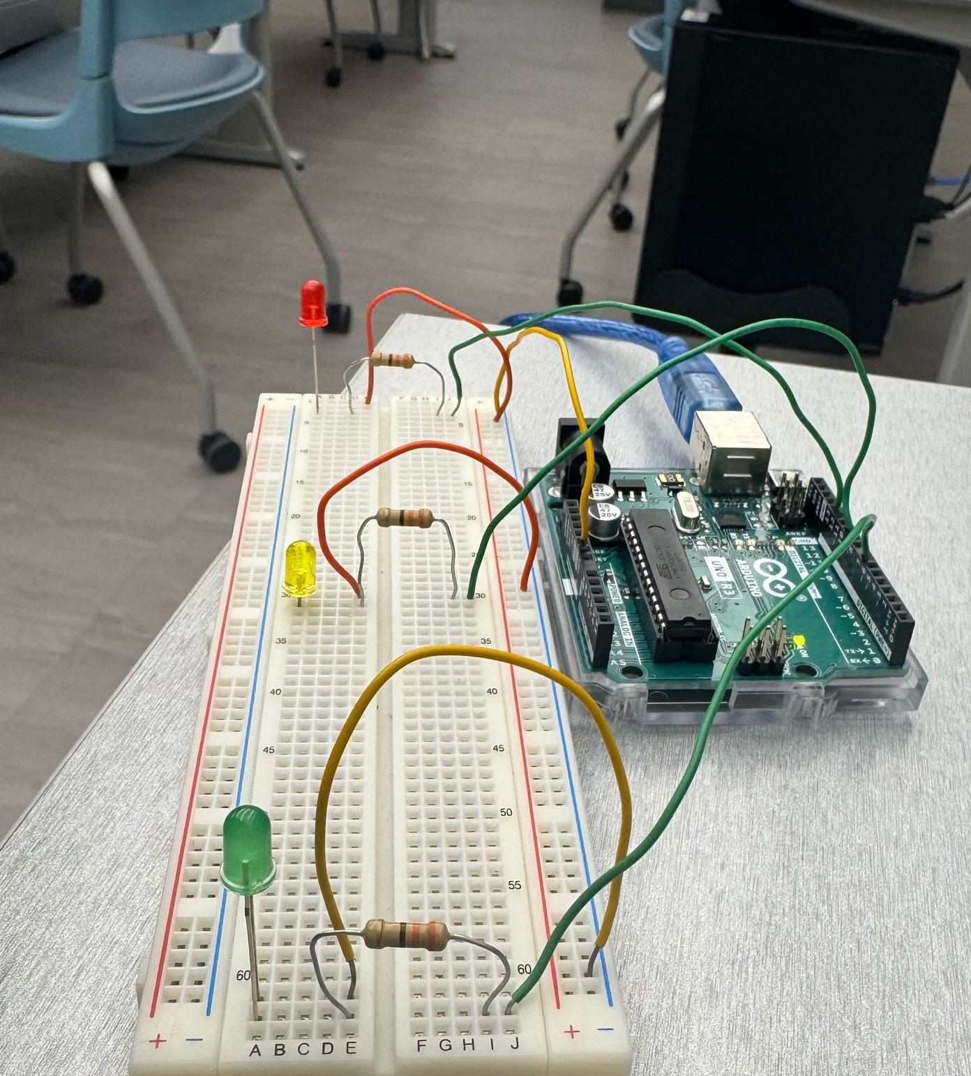
Bonus Design

Slide 5
Bonus in Action

